Slide 1
Women safety
- Nowadays, women and children safety is a primeissue of our society. The count of the victim are increasing day by day. In this paper, We are proposing a model which will
help to ensure the safety of women and children’s all over the
global.

Slide 2
INTRODUCTION:
At the present scenario Women are competing with men in every prospect of society.
Women contribute fifty percent to development of nation.
But the women have fear of getting harassed and killed.
the development of our nation. IoT (internet ofthings) is relatively new and fast-developing concept.
By using IoT-based technology guardians, relatives and police can monitor and track different sensors value and position of a device. A device is wearable and so it is easy to carry.

Slide 3
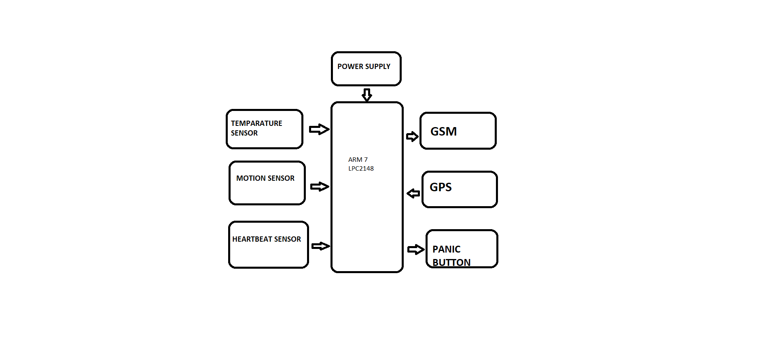
BLOCK DIAGRAM:

Slide 4
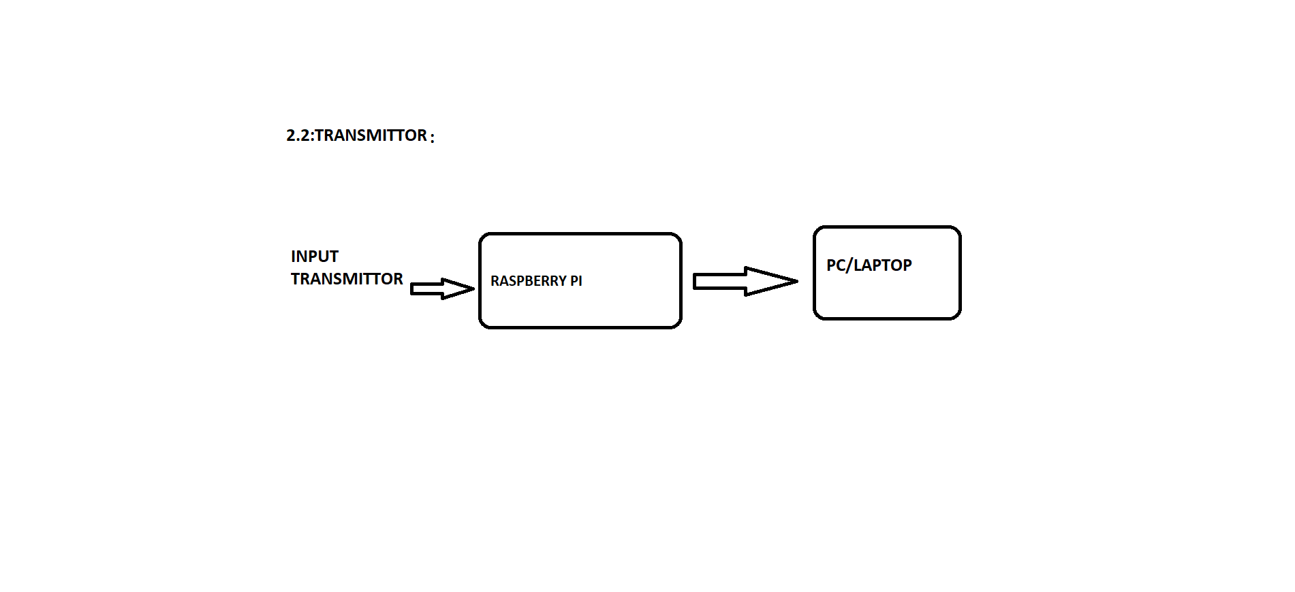
TRANSMITTER:

Slide 5
HARDWARE:
i)Microcontroller: Any ARM 7 microcontroller having twoUART ports can be used. In proposed model we have usedARM 7 LPC2148. LPC 2148 is 32/16 bit RISC microcontroller.It has two 10 bit ADC with 14 channel. It also has two UART port which used for GSM and GPS systems.
ii)Raspberry pi: Raspberry pi is single board computer. Its CPU speed ranges between 700MHZ and 1.2 GHZ. It also has on board memory between 256 MB and 1GB Ram. This is used at receiver to display values and position in terms oflatitude and longitude

Slide 6
iii) GPS: GPS stands for global positioning system. GPS isused to track the device. GPS gives a position of a device interms of latitude longitude and altitude. GPS is used to trackmoving device using satellite signal. When GPS is used thereis communication between GPS transceiver and GPS satellite.
iv) GSM:GSM stands for global system for mobile communication. GSM is a cellular technology which is usedfor voice and data transmission. GSM operates in-band of 900 MHZ to 1.8 GHZ. Through GSM it is possible to transmit SMS.

Slide 7
WORKING:
Proposed Model is wearable model. After giving powersupply to device , sensors on device will start taking readings. This readings are continuously sent to microcontroller. Microcontroller will compare this readings with the threshold values given to it .
This threshold values can vary from person to person. After comparing this threshold values , Microcontroller will send “Help” message accordingly.
GPS is used in device to continuously track device. Using IoT technology we can continuously monitor changes in sensors values. Position of device can also be track continuously. At the receiver side device like laptop, mobile phone, raspberry pi etc can be used to see sensor values and position.
The device at receiver should be connected to internet in order to receive data from transmitter.

Slide 8
CONCLUSION:
The proposed system is to ensure the security of the women in the society by providing automatic sensing of threats and send the “HELP&POSITION” to the relatives and the Police Station using Internet Of Things.

